Slide 1
Summary of Senior Design
Chriss Sanpakit

Slide 2
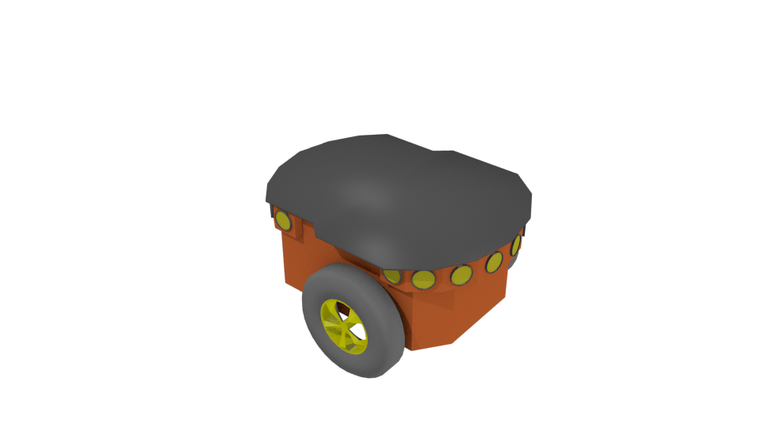
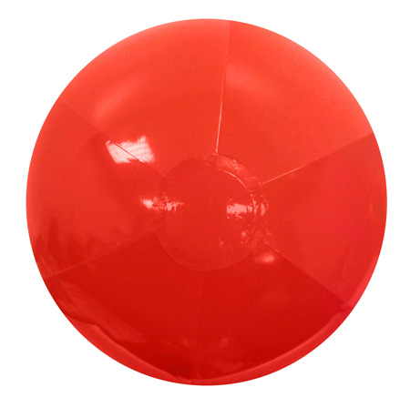
Cooperative Robotics – The objective
The goal is to perform a task that is either difficult or impossible with a single robot. We chose cooperative search

Slide 3
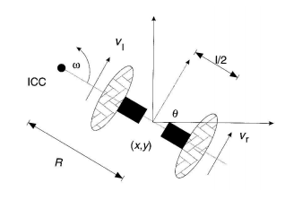
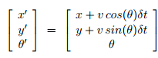
Governing Equations and Assumptions
Odometry Assumes no slip
Object location is not known a-priori
No obstacles currently, but boundaries exist
Holonomic Robot
Differential Drive Robot

Slide 4

How do we search for the target and does our proposed algorithm work?

Slide 5
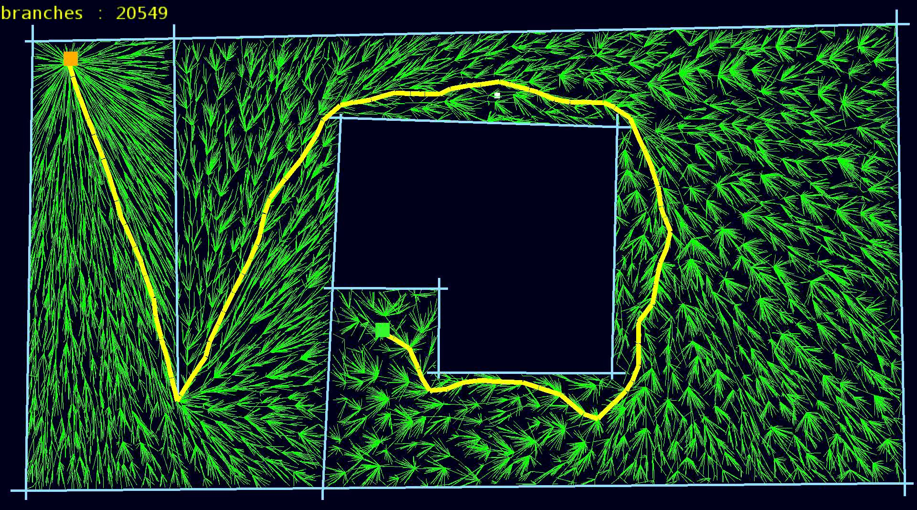
We built on Rapidly-Exploring Random Tree as Our Path Planning Algorithm
Photo by Laurie Bose at https://www.youtube.com/watch?v=r34XWEZ41HA

Slide 6
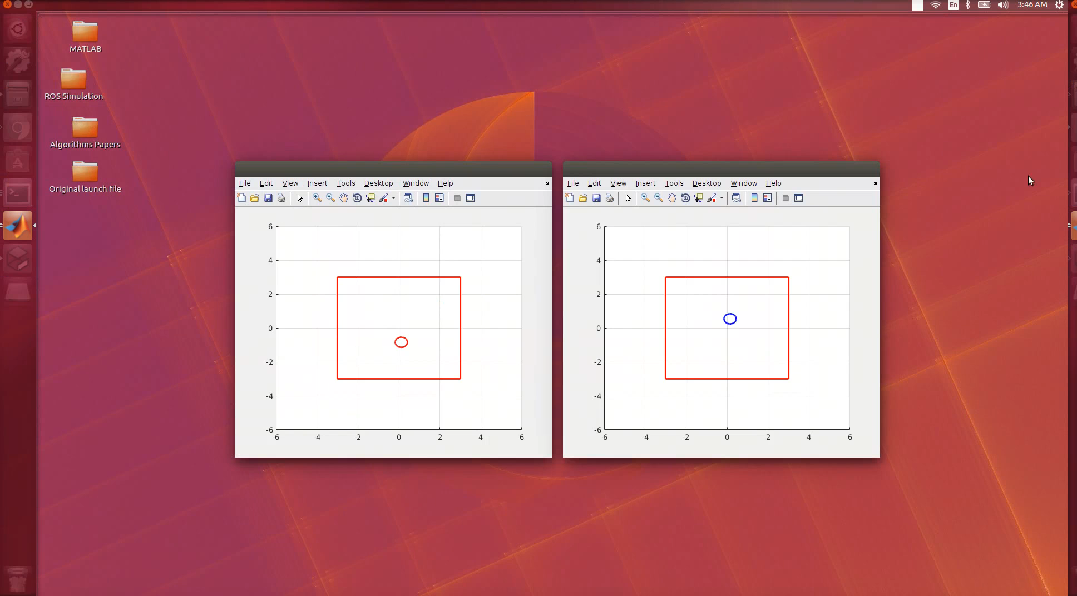
Two Robots Searching in Gazebo
Introduction
Path Planning
Sim & Analysis

Slide 7
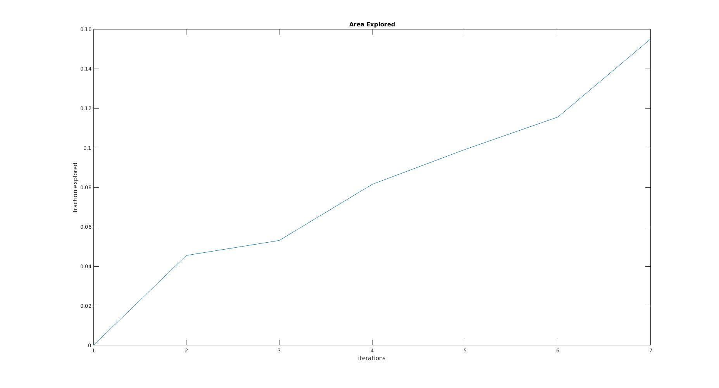
Specifically, we use the simulations to prove completeness of the algorithm
(Probabilistic) Completeness:
The algorithm always returns a solution if one exists
If there is no solution, the algorithm reports a failure
Area Explored
.16
.14
.12
.10
.08
.06
.04
.02
0
Fraction Explored
1
2
3
4
5
6
7
Iterations
Notes:
Chriss

Slide 8
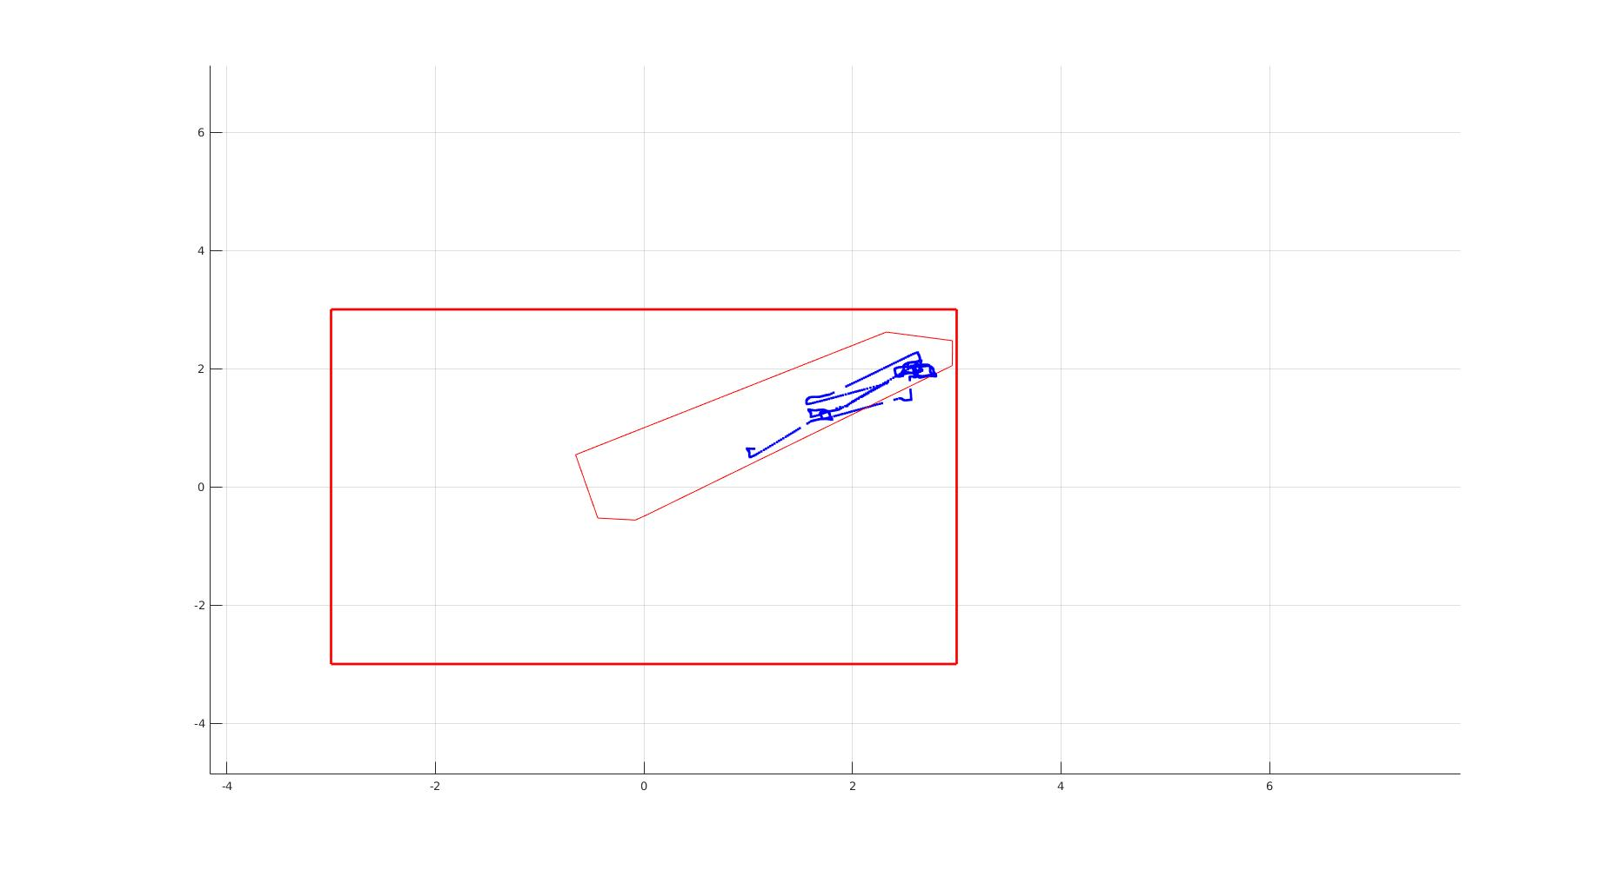
Simulations also show that if you use a naive search, the robot has a tendency to oscillate about a specific area
Notes:
Chriss

Slide 9
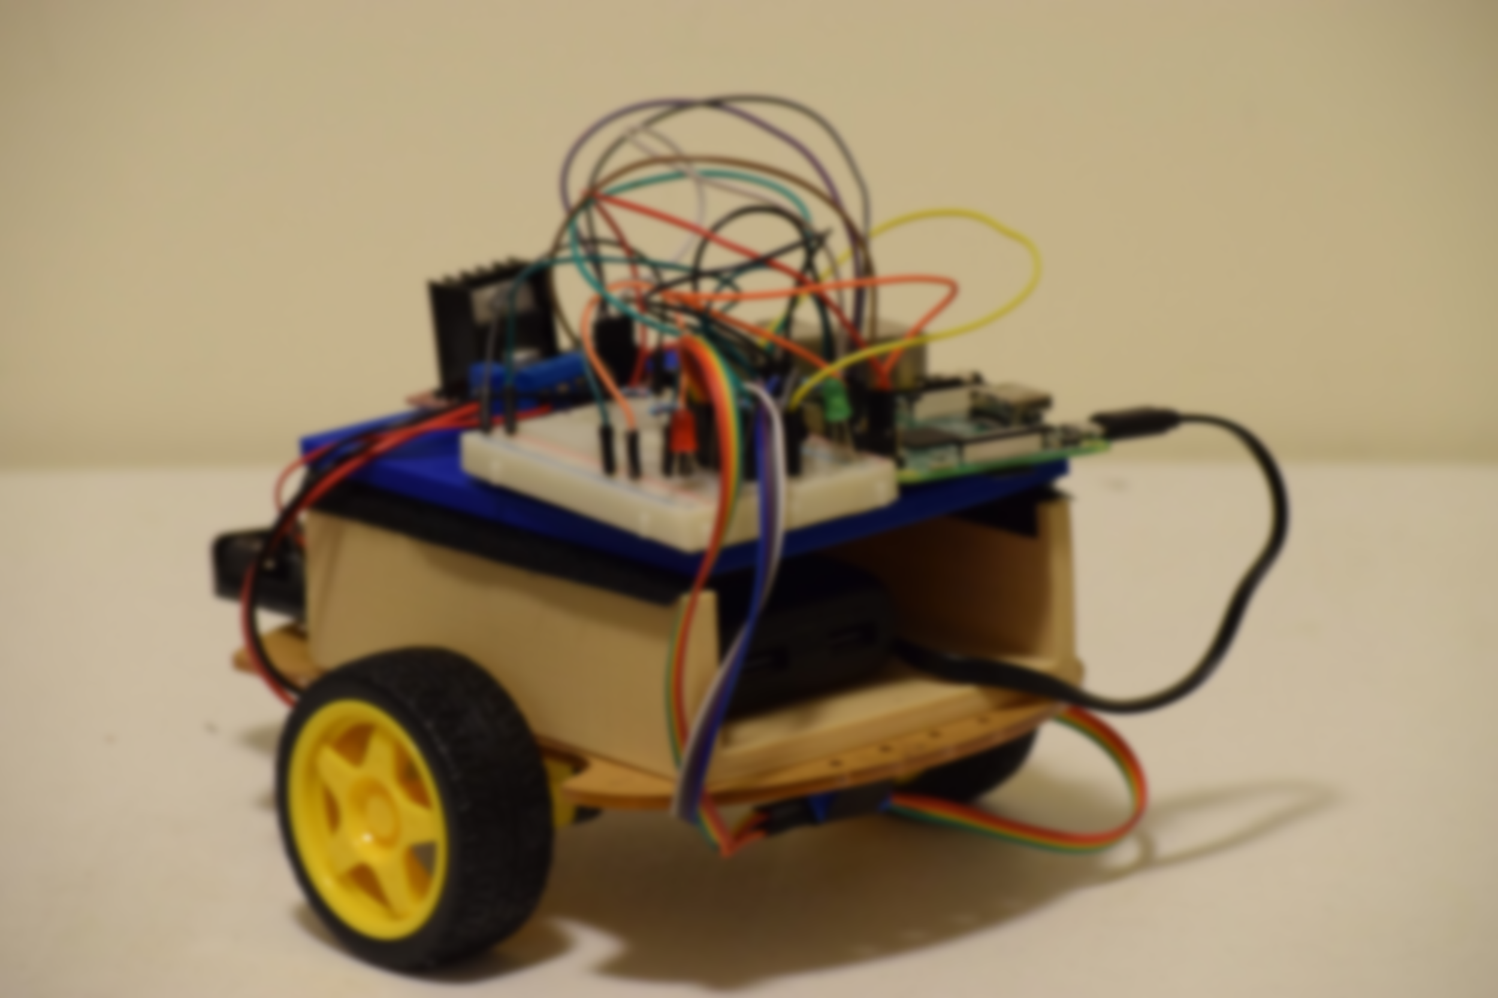
Final Design Solution

Slide 10
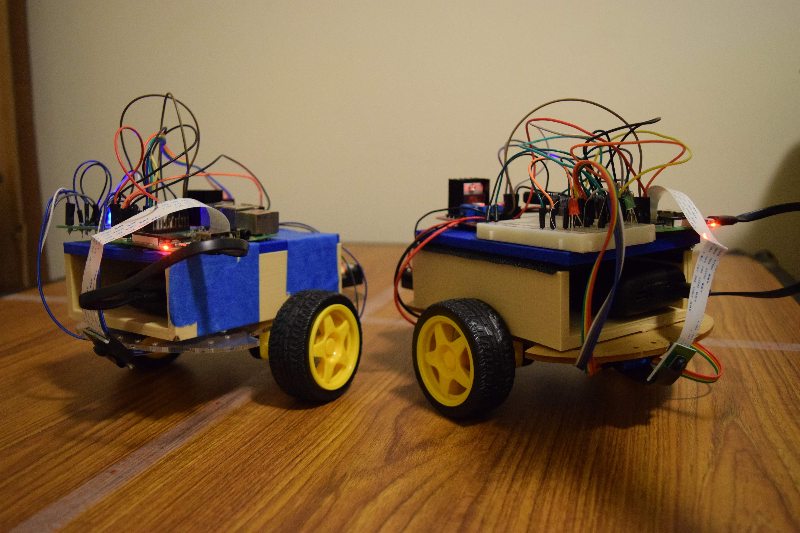
Maxwell and Elliot (M.E.)

Slide 11

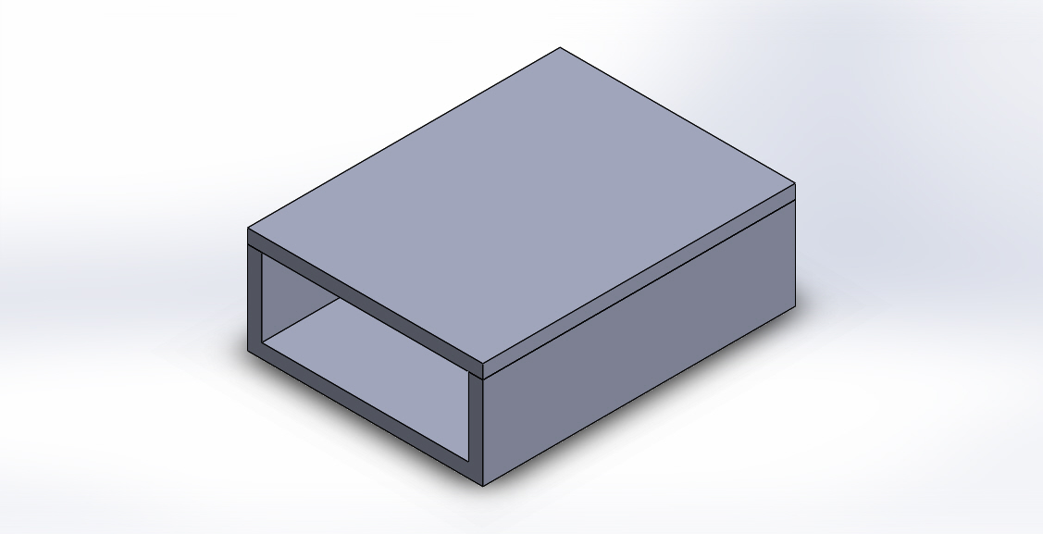
Physical Prototype
Purchased Parts
Raspberry Pi 3B
Arducam Camera
Wheel Encoders with Photo Interrupters
Chassis
External Battery Pack
Manufactured Parts
Electronic Housing Polylactic Acid (PLA)

Slide 12
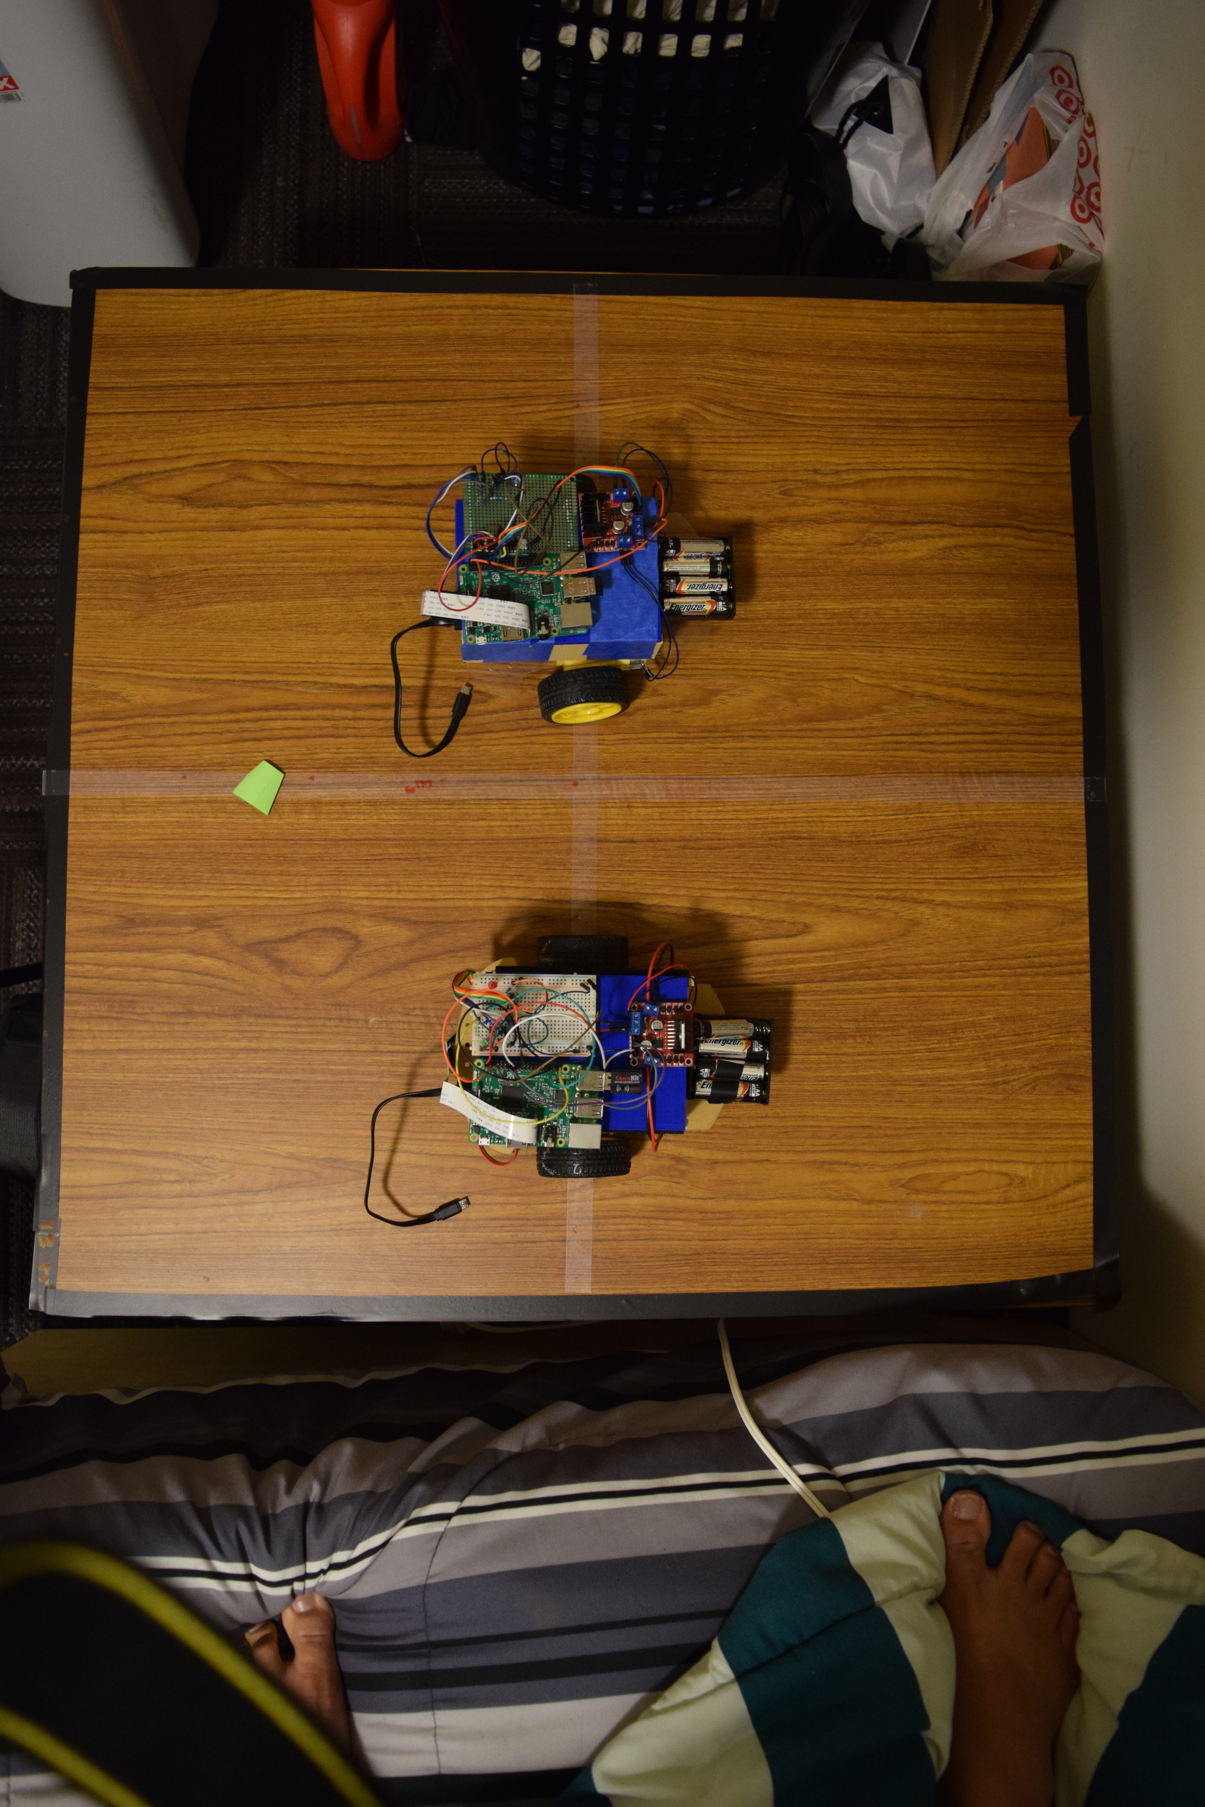
Experimental setup was designed to mimic a 2-D graph
(.4m, .4m)

Slide 13
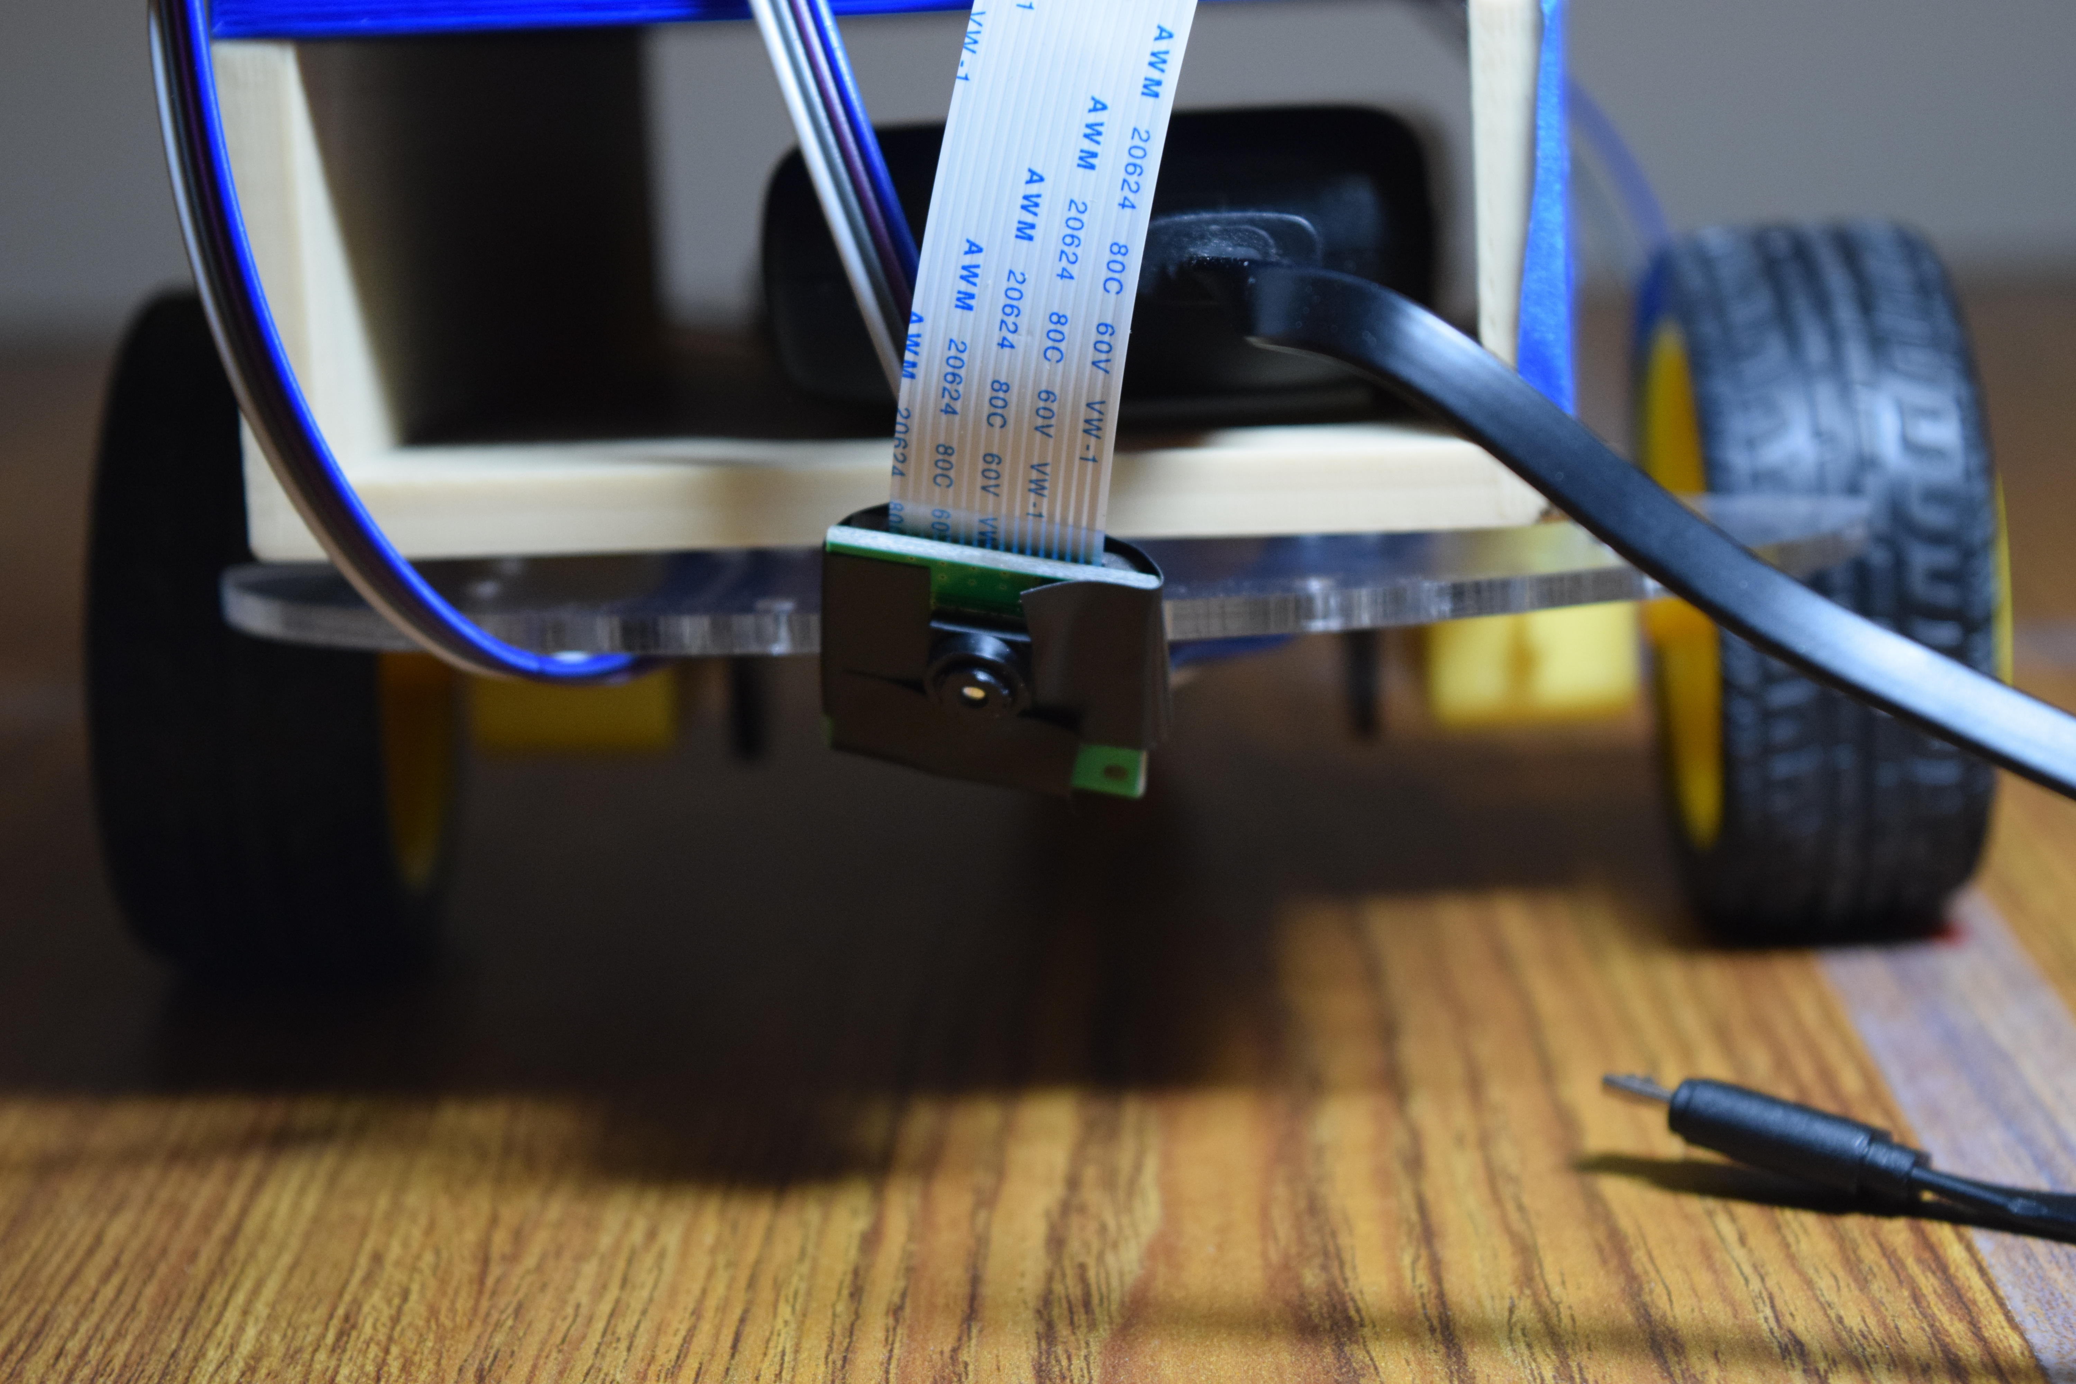
The camera was angled such that it does not find the target instantaneously

Slide 14
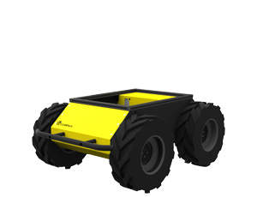


Computation is done on an external laptop and sent to the robots for low-level control
Experimental Framework Overview

Slide 15
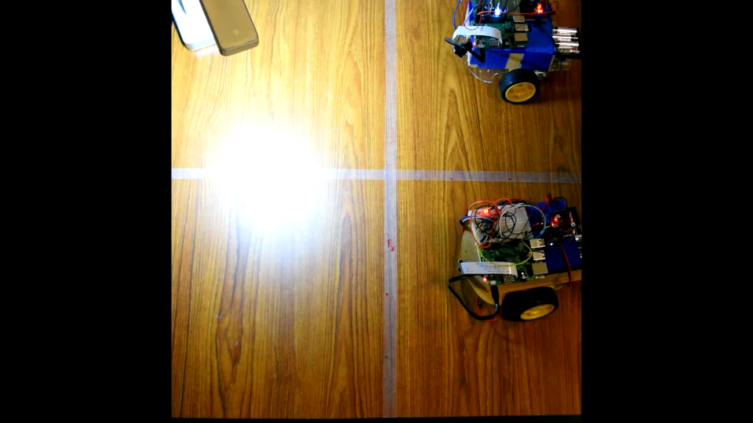
Experimentation proved successful (target was in the light here)
Elliott’s Pose: (.6, .6, 180)
Maxwell’s Pose: (.2, .6, 180)
Notes:
Chriss

